Slide 1
Lake Travis FFA Alumni
December 7, 2021

Slide 2
Agenda
Welcome
LDE Team Presentation
Minutes
Treasurer Report
Teacher Update
Past Month’s Event Recap
Sponsorship Drive/Fundraising Update
Upcoming Events (Chapter Show, Cav Classic, TCYS)
New Business
Upcoming Dates and Deadlines
Questions, Reminders, Adjourn

Slide 3
Minutes
Erica Koss
The minutes of the previous meeting are posted online.
Do we have a motion to accept the minutes as posted?

Slide 4
Treasurer’s Report
Jenn De Leon
Expenses: $3,329.92
Banking Software $26.65
Insurance $50
Cav Classic Expenses $1,428.27
Student Support: $1,825
Income: $13,977
Membership: $200
Sponsorship: $9,480
Pet Shot Clinic: $4,240
Signs / Decals: $57

Slide 5
Teacher Update
P. White
Barn Clean-up Reminders- Tuesday 12/14 Superintendent's Advisory Team Dinner here.
Process for/timing of clipping before shows, check out clippers from K White.
Pigs clipped after school Tuesday/Wednesday
Dec 14/15 (P White) Must be clean before clipping.
Cav Classic, we will haul animals to the show loading animals at 5 p.m.

Slide 6
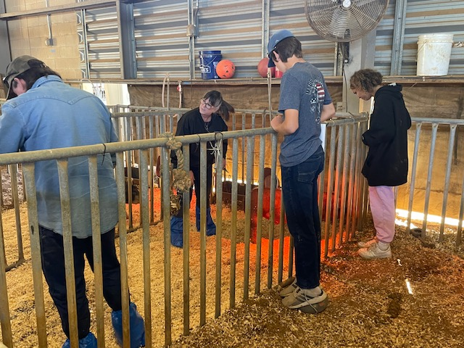
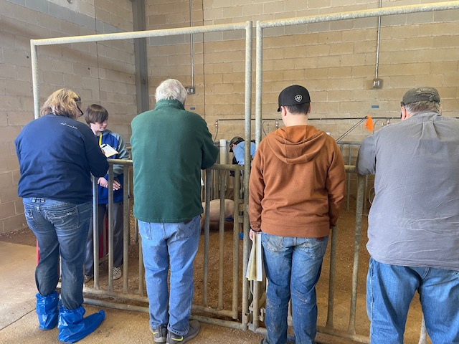
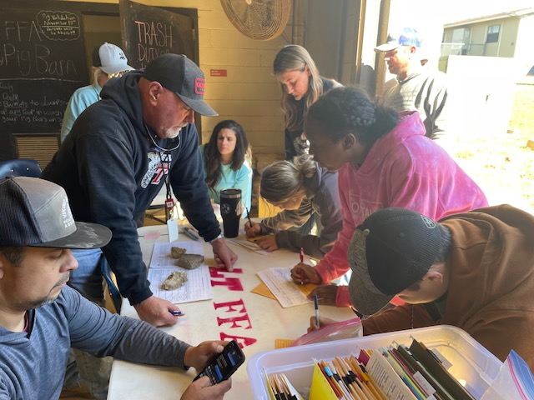
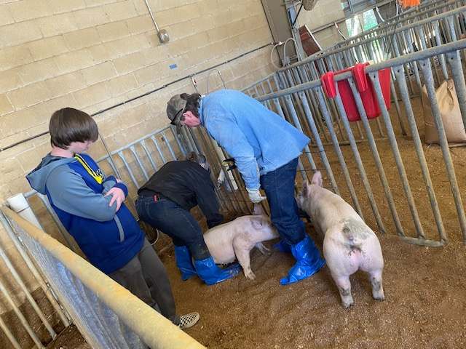
Pig Validation
Vanessa Jackson

Slide 7
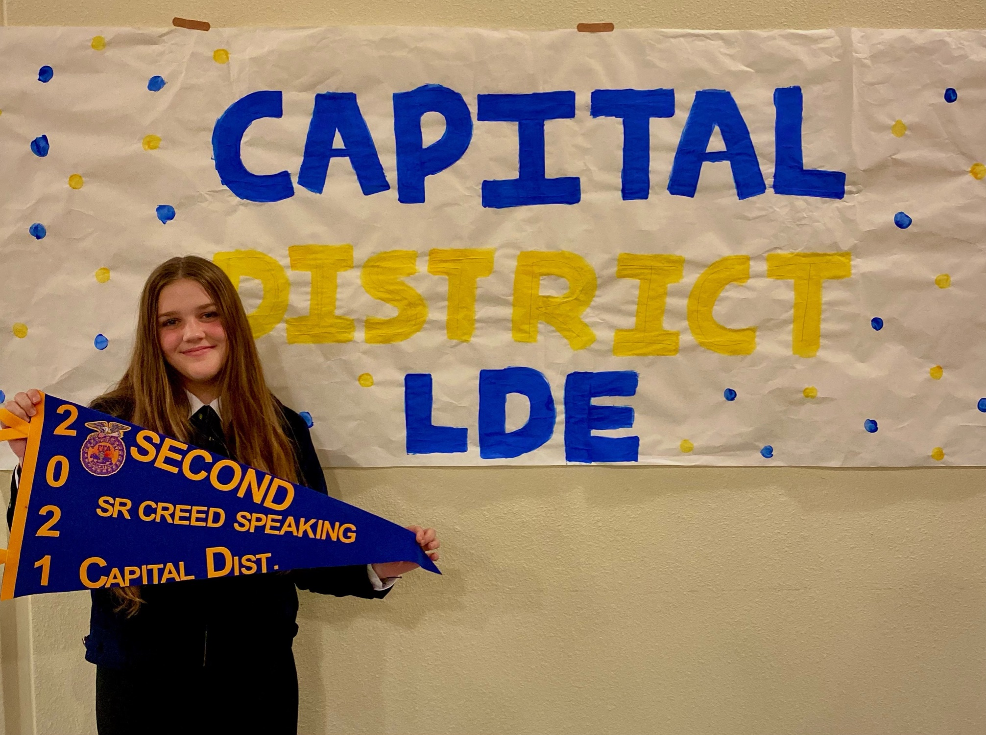
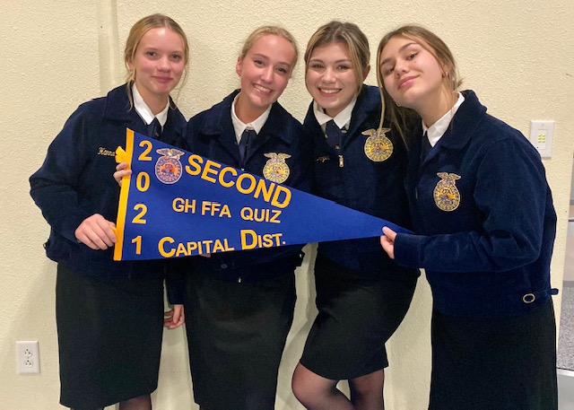
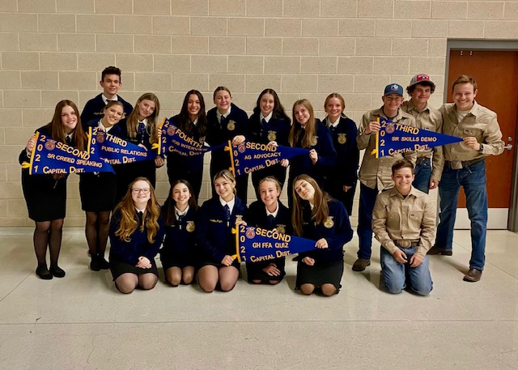
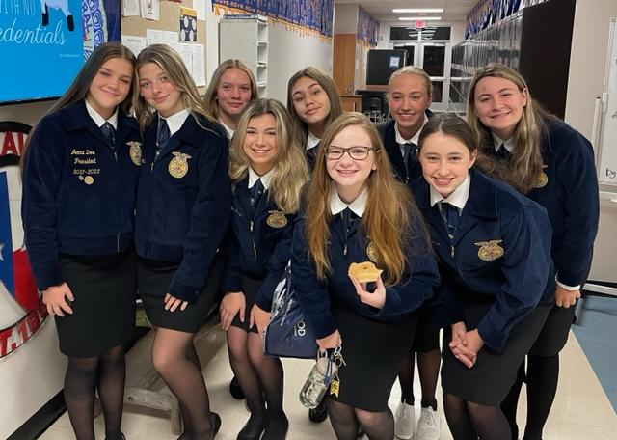
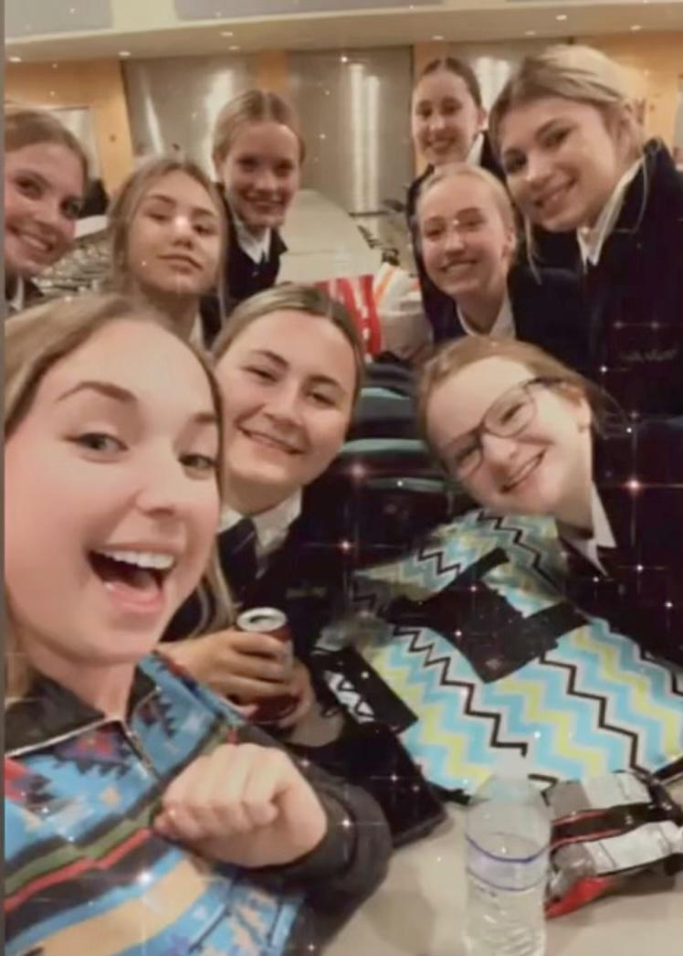
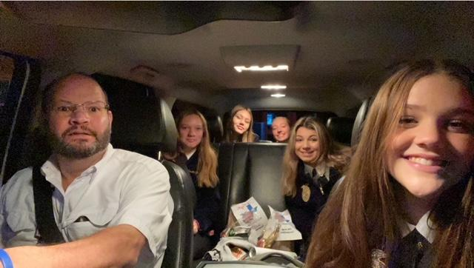
LDEs!

Slide 8
LDE Results
DISTRICT:
Ag Advocacy- 1st Jr. Quiz- 2nd Sr. Creed- 2nd
Public Relations- 3rd Sr. Skills-3rd
Job Interview- 4th GH Chapter Conducting - 4th Broadcasting- 6th
AREA:
Ag Advocacy- 6th Sr Creed - 7th Jr. Quiz- 8th

Slide 9
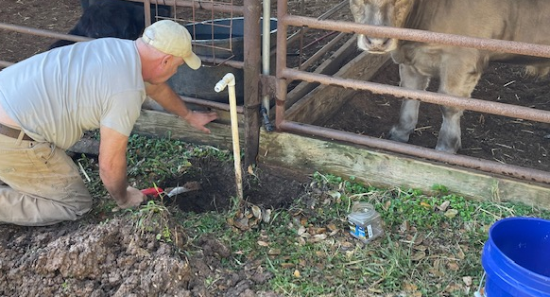
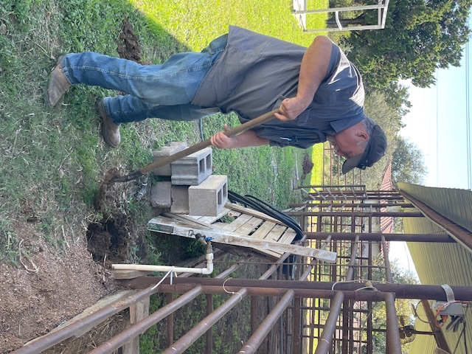
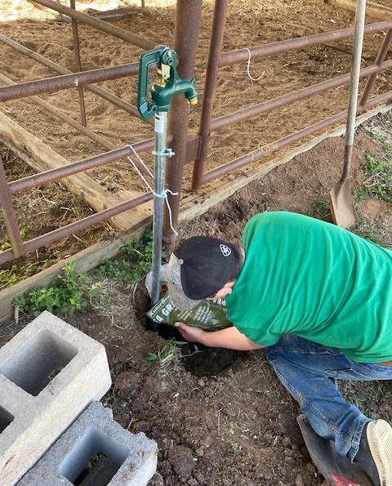
AntiFreeze Yard Hydrant Installation!
Thank you Jackson and Mallory Families!

Slide 10
Fundraising/Sponsorships
Jenn De Leon
Sponsorship Drive Results
The Goal…..
Each family raises at least $500
34 families – 145 Businesses
Goal = $17,000
The Results….
16 families – 73 Businesses (10 said yes)
4 families – took buyout / other sponsors
29 Sponsors: 21 business (10 from drive) & 8 family/friends
Sponsor amounts: $30 - $2,500
Current Total = $14,310

Slide 11
2021 - 2022 LT FFA Sponsors
THANK YOU!!!
Bronze
Lakeway Orthodontics
McCoys Building Supply
Triple S Feed & General Store
VIK Complete Care
Southern Way Farm & Stables
Lakeway Vision Associates
Silver
Flipnastics
Wild Hare Construction
Wildlife Management Services
Starfish Home Staging & Redesign
Nitro Swimming
Life Austin - Southwest
Amanda Ponce Team
Incavo

Slide 12
2021 - 2022 LT FFA Sponsors
THANK YOU!!!
Gold
Lakeway Veterinary Clinic
Diamond
Shipp Family Dentistry
Pittenger CPA, PC

Slide 13
2021 - 2022 LT FFA Sponsors
THANK YOU - FRIENDS & FAMILY!!!
Bronze
The Hatfield Family
Silver
The Cohen-Wise Family
Gold
The Foxx Family
Platinum
The Sulak Family

Slide 14
Kendra Gives Back
Opportunity to earn 20% of sales this weekend!
In-store: Lamar Central
Saturday 3-5pm
Need 3-4 students to attend
Online: Saturday & Sunday
Enter code GIVEBACK-BEQSE at checkout. This code will become active on 12/11 and remain active through 12/12 at midnight so there is plenty of time to shop!

Slide 15
Lake Travis FFA Chapter Show
Kathleen Fisher
Friday December 17, 2021
Dripping Spring Ranch Park -- camping available with your own camper or rentals through ISPYRV (see Kathleen; RESERVATION DEADLINE FRIDAY DECEMBER 10)
All species PLUS Showmanship for all
Load at school: 5 p.m.
Show starts at 7 p.m.
Weight cards & $30 entrydue day before by 6 p.m. on Dec 16th
Dinner available Friday night
Lambs/Goats need to clip week before

Slide 16
Lake Travis FFA Cavalier Classic
Alisia Fee
Dripping Spring Ranch Park -- camping available
All species PLUS Showmanship for all -- buckles and cash prizes
Set-up 2 p.m. Friday – NEED VOLUNTEERS
RINGSIDE VOLUNTEERS NEEDED
Tear down will be immediately following show
Registration 6-9 a.m.; Show starts at 10 a.m.

Slide 17
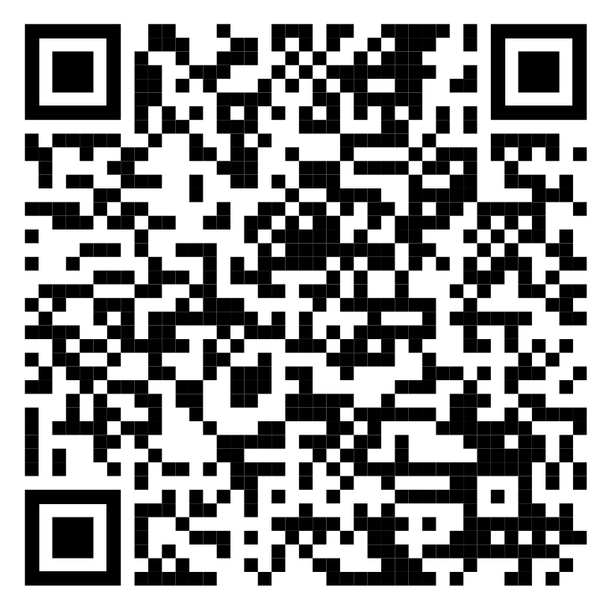
Cav Classic Volunteers Sign Up
Alisia Fee
https://docs.google.com/spreadsheets/d/1V1mjL-kQ7D4OL0rhsG4O3ACe30uZzqhiuLlTsnk90pg/edit?usp=sharing

Slide 18
TCYS Updates
Kathleen Fisher
Rabbit Validation = December 11
Eligibility Deadline = December 16
Youth Fair = Saturday 1/8/22 Pflugerville Lions Club
Livestock show location TBD
Lambs/Goats need to clip week before
Barn Set-up Wednesday January 12
Rabbits/poultry show on Thursday January 13
Lambs/goats show on Friday January 14
Steers/pigs show on Saturday January 15
Barn Clean-up Sunday January 16
Pigs need one bag shavings each

Slide 19
Major Shows
Kathleen Fisher
Mid-January = Fort Worth
Mid-February = San Antonio, San Angelo (LT will trailer to San Antonio only)
Mid-March = Rodeo Austin, Houston
You will need hotel for show you are going to -- see Whites for more info

Slide 20
Upcoming Dates & Deadlines
Vanessa Jackson
December 9 = Student meeting and Christmas Party (gift exchange $15)
December 10 = Camping reservation deadline for December 17-19
December 10 = Student bonding event ELF 5:15 p.m. Spindle’s Room
December 11 = Student volunteer opportunity, Texas Humane Heroes
December 11 = Rabbit Validation
December 16 = Grades get checked
December 17 = LT FFA Chapter Show
December 18 = Cavalier Classic
January 4, 6pm = Next Alumni Meeting
January 13-15, 2022 = TCYS

Slide 21
Membership Reminders
Erica Koss
Sign-in and double check info
Please complete membership forms ASAP
Volunteer sign-up for Cantina and Cav Classic
See Kathleen for RV rental info for December 17-18

Slide 22
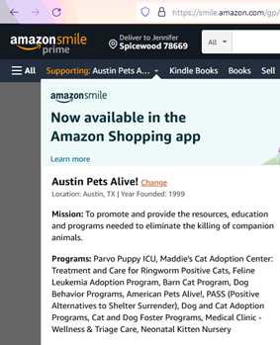
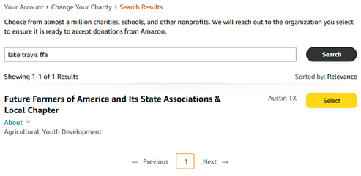
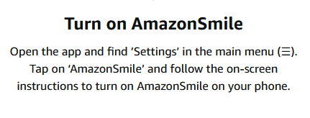
Amazon Smile
Update your account to support LT FFA!!
Use the Amazon app?

Slide 23
Join Remind Group Alerts
Text number: 81010
•FFA Texts - @lt-ffa
•Pigs - @oinker
•Goats - @goat
•Lambs - @ltlambs

Slide 24
Next Meeting Jan 4 (6pm)
Meeting
Adjourned
Thank you for attending!

